Slide 1

Optimizing Query Performance with Execution Plans and Indexing Strategies
Database Management System | SQL and Advanced Query Formulation
Course: Database Management System | Chapter: SQL and Advanced Query Formulation | Program: B.TECH-CSE, B.TECH CSE - CYBER SECURITY, B.TECH CSE - DATA
DISCOVER · LEARN · EMPOWER
Notes:
Welcome everyone to today's lecture on optimizing query performance. We will focus specifically on how execution plans and indexing strategies transform slow queries into fast ones. This is a critical skill for any database professional working with large datasets.

Slide 2
Course Outcomes
SLIDE 2 / 14
Course Outcome
CO | BT LEVEL | DESCRIPTION
CO1 | BT2 | Explain database architecture, relational model concepts and formal query language foundations including relational algebra and relational calculus.
CO2 | BT3 | Apply relational algebra, relational calculus and SQL constructs to formulate correct and efficient database queries.
CO3 | BT4 | Analyze functional dependencies and design normalized relational schemas up to 5NF ensuring lossless join and dependency preservation.
CO4 | BT4 | Analyze transaction schedules and concurrency control mechanisms to determine serializability, recoverability and correctness.
CO5 | BT5 | Evaluate storage structures, indexing strategies and query optimization techniques for performance, scalability and reliability.
Chandigarh University
2 / 14
Notes:
Today's session directly addresses our first two course outcomes. You will learn to explain the architectural foundations of query optimization and apply SQL constructs to formulate efficient queries. Understanding these outcomes is key to mastering database performance tuning.

Slide 3
Learning Objectives
SLIDE 3 / 14
Learning Outcomes
1
Define the role of execution plans in query processing.
2
Identify common indexing strategies for performance improvement.
3
Analyze how indexes reduce disk I/O operations.
4
Evaluate the trade-offs between read speed and write overhead.
5
Interpret basic execution plan statistics for optimization.
Chandigarh University
3 / 14
Notes:
By the end of this lecture, you will be able to define execution plans and identify specific indexing strategies. We will analyze how these indexes reduce the heavy disk I/O operations that slow down databases. Finally, you will learn to evaluate the trade-offs between faster reads and slower writes.

Slide 4
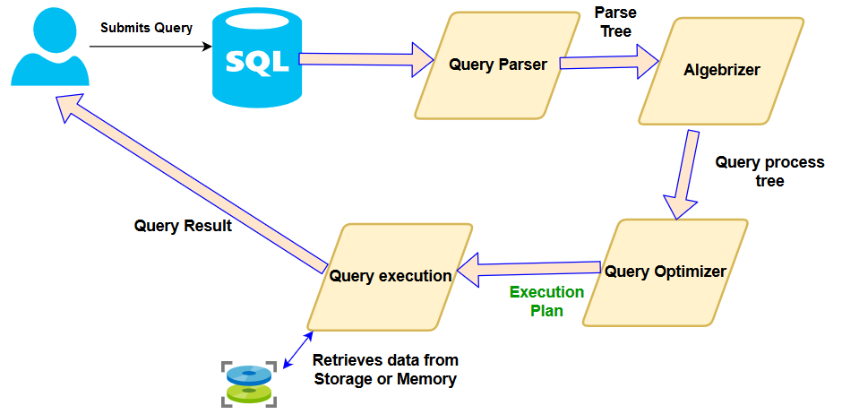
Lecture
SLIDE 4 / 14
Understanding Execution Plans
1
An execution plan is a step-by-step guide for the database engine.
2
It details how the engine retrieves data from physical storage.
3
The optimizer generates the plan based on table statistics.
4
Plans determine the order of joins and index usage.
5
Poor plans often result in full table scans instead of index scans.
6
Visualizing the plan helps identify performance bottlenecks effectively.
SQL Server execution plan overview and usage
Chandigarh University
4 / 14
Notes:
Think of an execution plan as a recipe that the database follows to answer your query. The optimizer creates this plan by analyzing statistics about your data distribution. If the plan chooses a full table scan, it reads every row, which is slow. Visualizing this plan allows us to see exactly where the database is struggling.

Slide 5
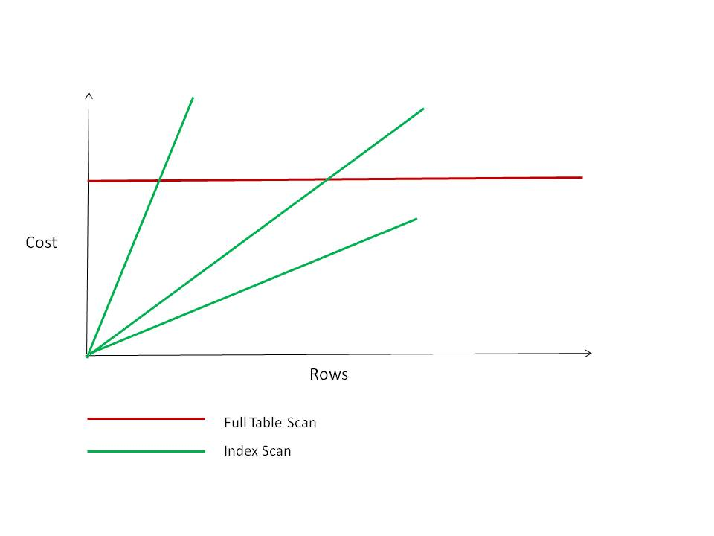
Lecture
SLIDE 5 / 14
Full Table Scans vs Index Scans
1
A full table scan reads every row in the table sequentially.
2
An index scan reads only the relevant rows via a B-tree.
3
Full scans are efficient for small tables or returning most rows.
4
Index scans are superior for selective queries on large datasets.
5
The cost of a full scan grows linearly with table size.
6
The cost of an index scan remains logarithmic regardless of size.
Source: richardfoote.wordpress.com
Chandigarh University
5 / 14
Notes:
Imagine a library with a million books. A full table scan is like reading every single book to find one title. An index scan is like using the card catalog to find the shelf location immediately. The cost of a full scan grows linearly as the table gets bigger, while an index scan stays logarithmic.

Slide 6
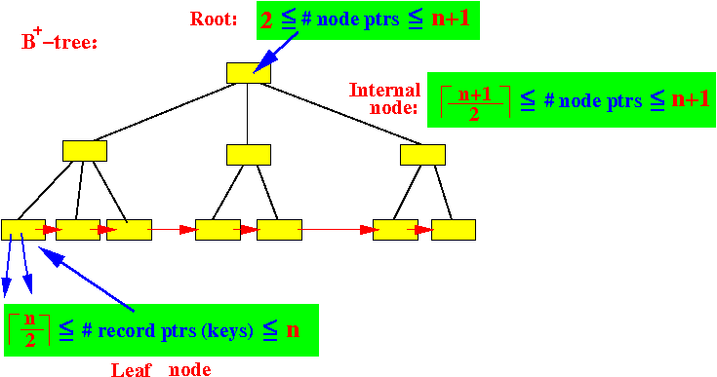
Lecture
SLIDE 6 / 14
B-Tree Index Structure
1
B-trees are balanced tree structures used for most database indexes.
2
They maintain sorted data for efficient range and equality searches.
3
The root node guides the search to the correct leaf node.
4
Leaf nodes contain the actual data pointers or values.
5
Search complexity is O(log n) for any data size.
6
Insertions and deletions automatically rebalance the tree structure.
Source: www.cs.emory.edu
Chandigarh University
6 / 14
Notes:
The B-tree is the workhorse of database indexing because it keeps data sorted and balanced. The root node acts as a guide, directing the search to the correct leaf node quickly. This structure ensures that even with millions of rows, the search complexity remains logarithmic. This means the time to find a record grows very slowly as the data expands.

Slide 7
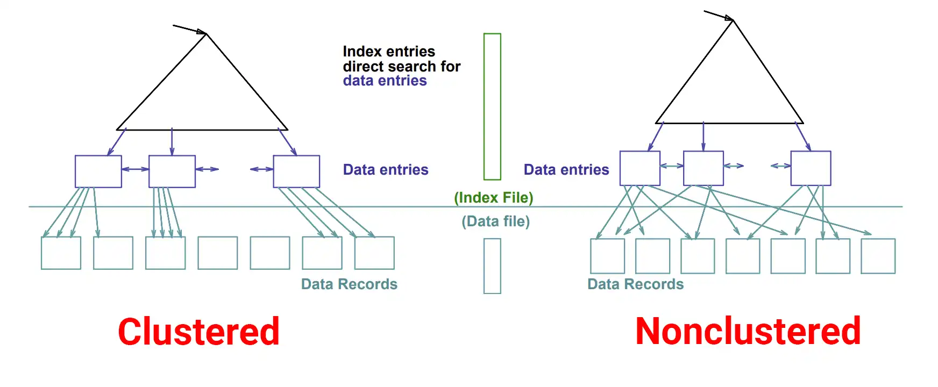
Lecture
SLIDE 7 / 14
Clustered vs Non-Clustered Indexes
1
A clustered index determines the physical order of data rows.
2
A table can have only one clustered index per table.
3
Non-clustered indexes store a separate structure with pointers.
4
Non-clustered indexes allow multiple indexes on a single table.
5
Clustered indexes are ideal for range queries on primary keys.
6
Non-clustered indexes are best for frequent lookups on secondary keys.
Source: josipmisko.com
Chandigarh University
7 / 14
Notes:
A clustered index physically sorts the data rows on the disk, so a table can only have one. This makes it ideal for range queries on primary keys. A non-clustered index is a separate structure that points to the data rows. You can have multiple non-clustered indexes, making them perfect for secondary key lookups.

Slide 8
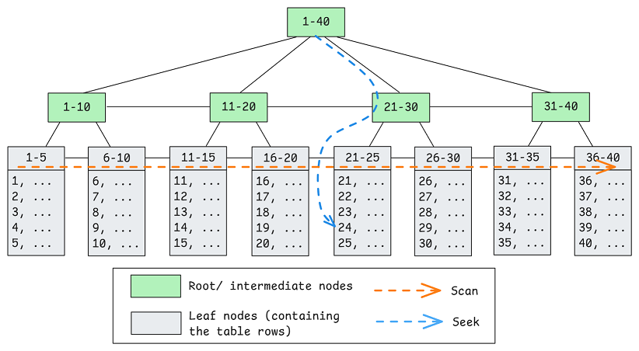
Lecture
SLIDE 8 / 14
Covering Indexes Explained
1
A covering index contains all columns required by a specific query.
2
The database can satisfy the query using only the index.
3
This eliminates the need to access the actual table data.
4
Covering indexes significantly reduce disk I/O operations.
5
They are created by including additional columns in the index.
6
Overuse can increase storage requirements and write overhead.
Source: images.squarespace-cdn.com
Chandigarh University
8 / 14
Notes:
A covering index is a powerful optimization where the index contains every column the query needs. The database can answer the query using only the index, avoiding the slower table access. This drastically reduces disk I/O operations for that specific query. However, you must be careful not to overuse them as they increase storage and slow down writes.

Slide 9
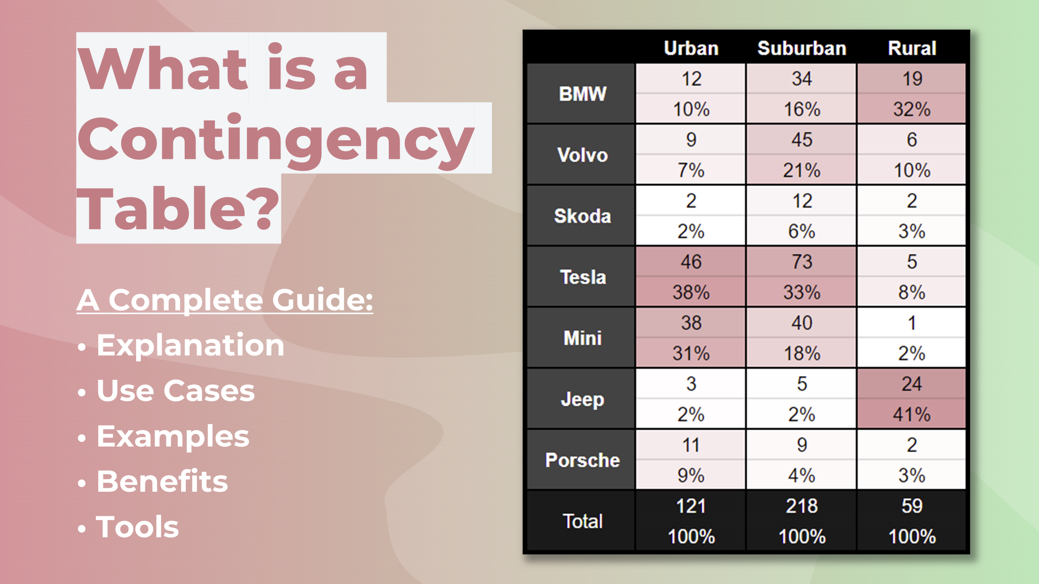
Worked Example
SLIDE 9 / 14
Query Cost Analysis
GOVERNING EQUATION
Query: SELECT × FROM Orders WHERE CustomerID = 105
SCENARIO A
No index requires scanning 1,000,000 rows.
SCENARIO B
Index on CustomerID requires scanning 50 rows.
COST A
1,000,000 disk I/O operations (Full Scan).
COST B
50 disk I/O operations (Index Scan).
SPEEDUP
Scenario B is 20,000 × faster than Scenario A.
Source: images.squarespace-cdn.com
Chandigarh University
9 / 14
Notes:
Let's look at a concrete example. If you query for a specific customer in a table of one million rows without an index, the database must scan every single row. This requires one million disk I/O operations. With an index, it only needs to scan the 50 matching rows. This results in a 20,000-fold speedup, demonstrating the massive impact of indexing.

Slide 10
Lecture
SLIDE 10 / 14
Index Selectivity and Cardinality
1
Selectivity measures the uniqueness of values in a column.
2
High selectivity means most values are unique, like an ID.
3
Low selectivity means many rows share the same value, like gender.
4
High selectivity columns yield the best index performance.
5
Low selectivity columns often lead to full table scans.
6
The optimizer chooses indexes based on estimated selectivity.
Chandigarh University
10 / 14
Notes:
Selectivity is a measure of how unique the values in a column are. A column like an ID has high selectivity because every value is unique. A column like gender has low selectivity because only a few values exist. The optimizer uses this selectivity to decide whether an index will actually help or if a full scan is better.

Slide 11
Lecture
SLIDE 11 / 14
Composite Indexes for Multi-Column Queries
1
Composite indexes cover multiple columns in a single structure.
2
They are effective for queries filtering on multiple columns.
3
The order of columns in the index matters significantly.
4
The leftmost prefix rule applies to composite index usage.
5
An index on (A, B) supports queries on A and (A, B).
6
It does not support queries filtering only on column B.
Chandigarh University
11 / 14
Notes:
Composite indexes allow you to index multiple columns together for complex queries. However, the order of columns is critical due to the leftmost prefix rule. An index on columns A and B can be used for queries filtering on A alone or both A and B. It cannot be used efficiently if the query only filters on column B.

Slide 12
Lecture
SLIDE 12 / 14
Common Pitfalls in Indexing
1
Creating too many indexes slows down write operations significantly.
2
Indexing columns with low selectivity wastes storage and time.
3
Ignoring the leftmost prefix rule renders composite indexes useless.
4
Using functions on indexed columns prevents index usage.
5
Not updating statistics leads to poor execution plan choices.
6
Over-indexing increases maintenance overhead and storage costs.
Chandigarh University
12 / 14
Notes:
There are several common pitfalls you must avoid when indexing. Creating too many indexes will slow down your write operations because the database must update every index on every change. Ignoring the leftmost prefix rule or using functions on indexed columns can render your indexes completely useless. Always remember that indexes are not free; they come with storage and maintenance costs.

Slide 13
Lecture
SLIDE 13 / 14
Key Takeaways
1
Execution plans dictate how the database retrieves data efficiently.
2
B-tree indexes provide logarithmic search performance for large data.
3
Clustered indexes sort data physically while non-clustered are separate.
4
Covering indexes eliminate table access by including all needed columns.
5
Selectivity determines whether an index will improve query speed.
Chandigarh University
13 / 14
Notes:
To summarize, execution plans are the roadmap the database follows to retrieve data. B-tree indexes are essential for achieving logarithmic search performance on large datasets. Remember the distinction between clustered and non-clustered indexes and how covering indexes can eliminate table access. Finally, always consider selectivity before creating an index to ensure it actually improves performance.

Slide 14
Lecture
SLIDE 14 / 14
References
1
Fundamentals of Database Systems — Ramez Elmasri & Shamkant B. Navathe
2
Database System Concepts — Silberschatz, Korth & Sudarshan
3
Database Management Systems — Raghu Ramakrishnan & Johannes Gehrke
4
Oracle/MySQL Documentation — Oracle
Chandigarh University
14 / 14
Notes:
For further reading, I recommend the standard texts by Elmasri and Navathe, as well as Silberschatz. The book by Ramakrishnan and Gehrke provides excellent practical insights into query optimization. Finally, always consult the official Oracle and MySQL documentation for the latest syntax and features.

